Slide 1


Slide 5


Are You…
Looking for a car?
In a tight budget?
Not picky?
This Photo by Unknown Author is licensed under CC BY-ND

Slide 6
Are You…
Looking for a car?
In a tight budget?
Not picky?
This Photo by Unknown Author is licensed under CC BY-ND

Slide 7


Interactive
Website
Find cars at
a good price
Updated daily

Slide 8

New & Used
Sedans
SUV’s
EV’s

Slide 9
New & Used
Sedans
SUV’s
EV’s
From
Dodge
Alfa Romeo
Tesla
+ More

Slide 10
New & Used
Sedans
SUV’s
EV’s
From
Dodge
Alfa Romeo
Tesla
+ More

Slide 11
Home Page

Slide 12
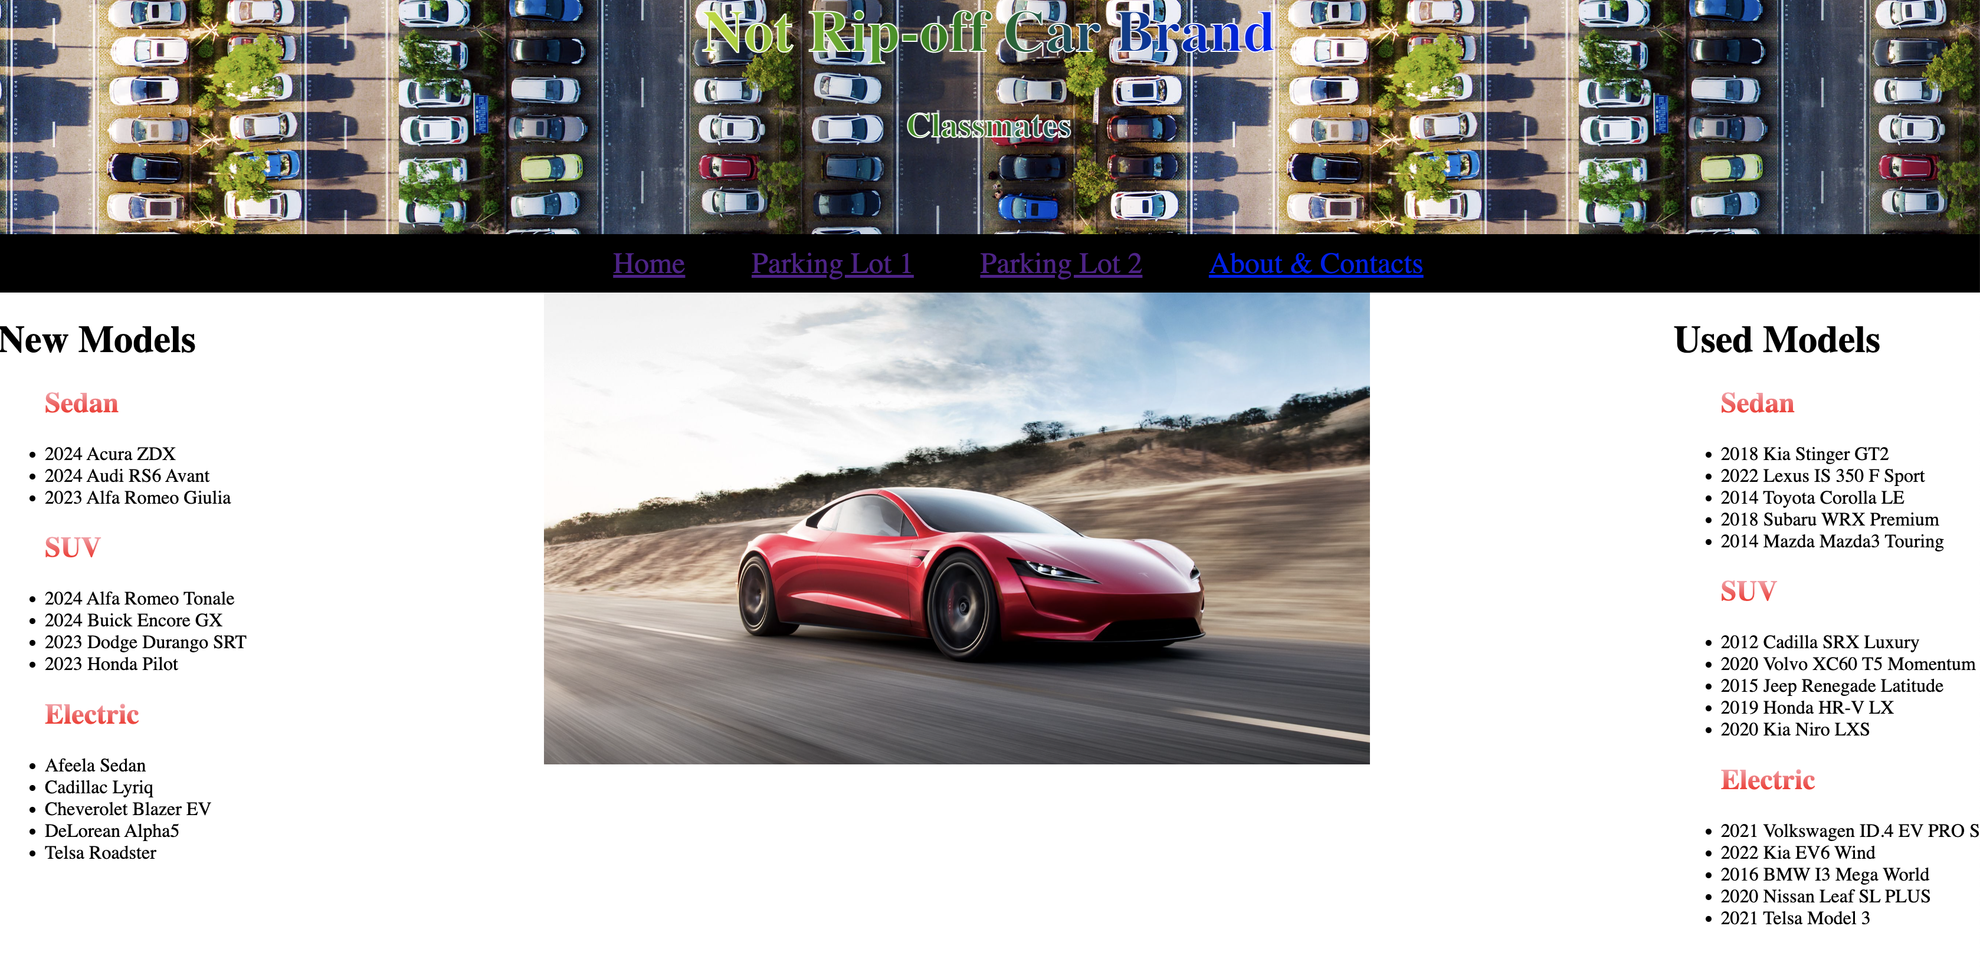

Slide 14
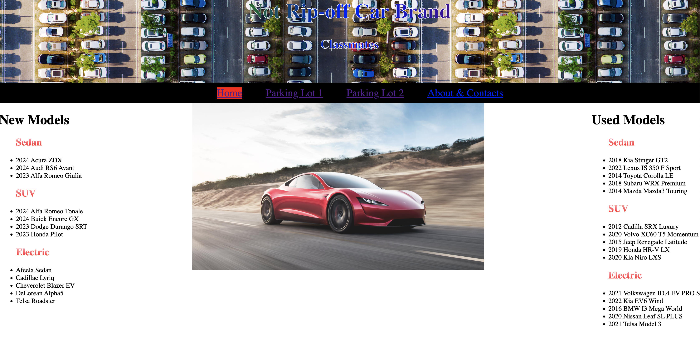

Slide 16
Formatting /
Styling

Slide 17
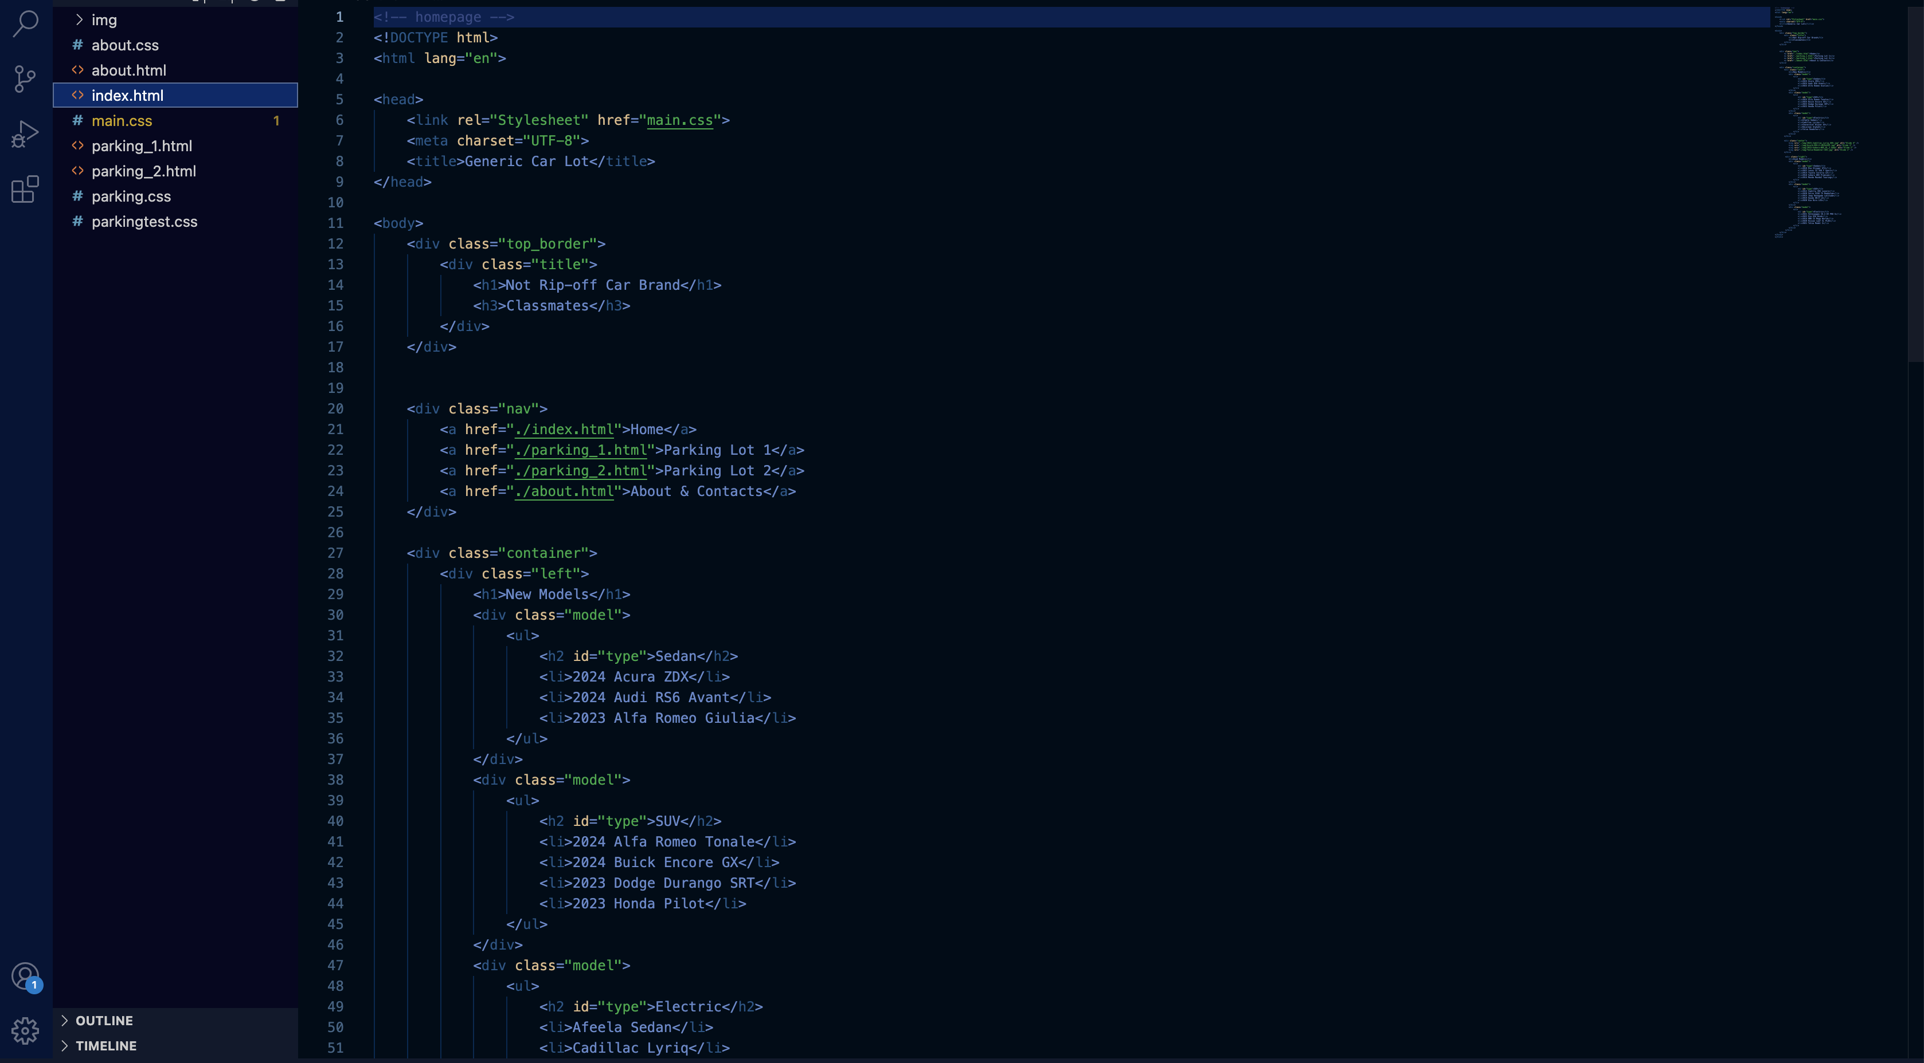
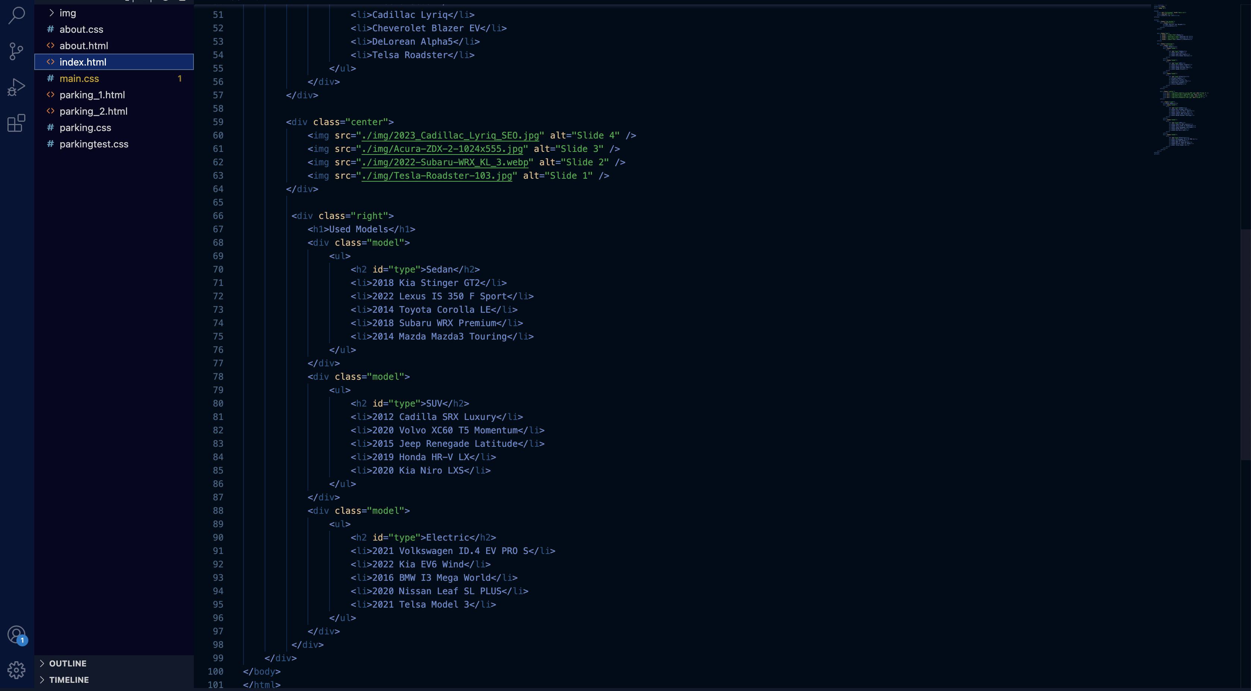

Slide 18
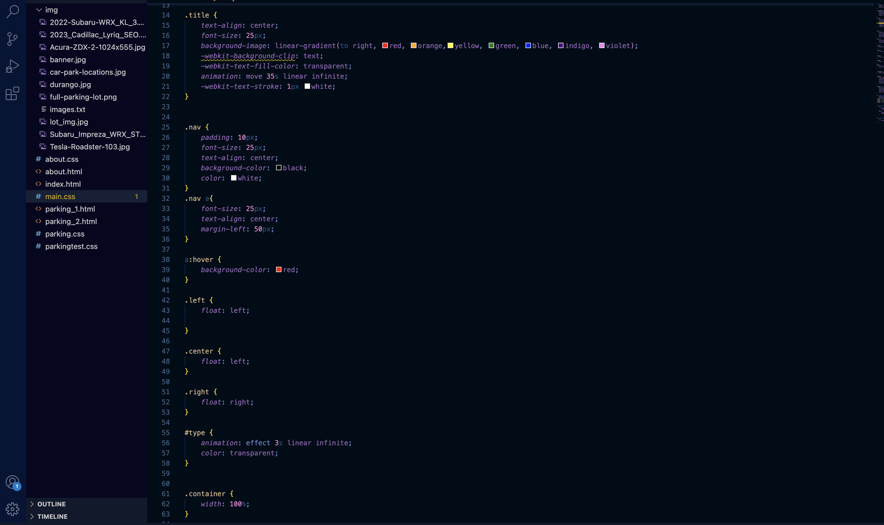

Slide 19
Parking Lot

Slide 20
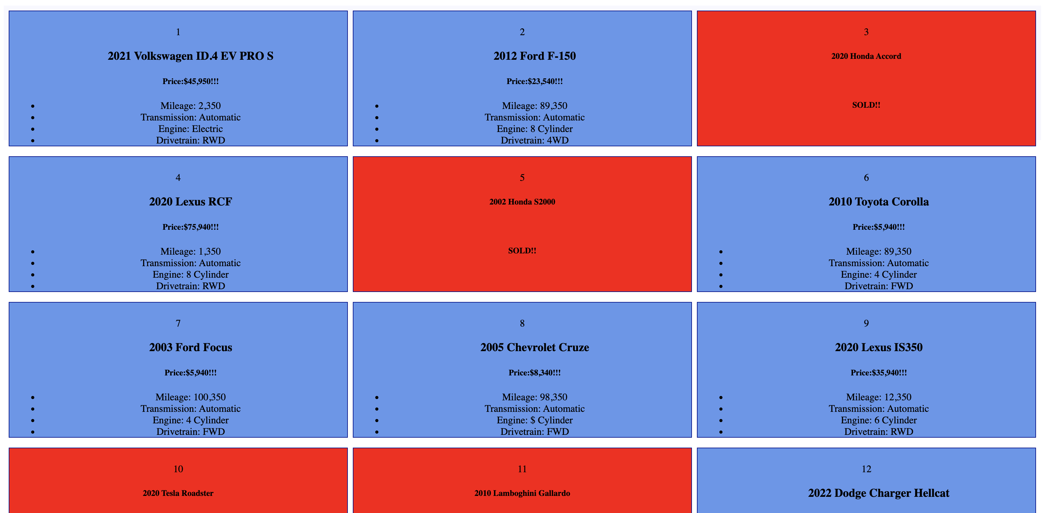

Slide 21
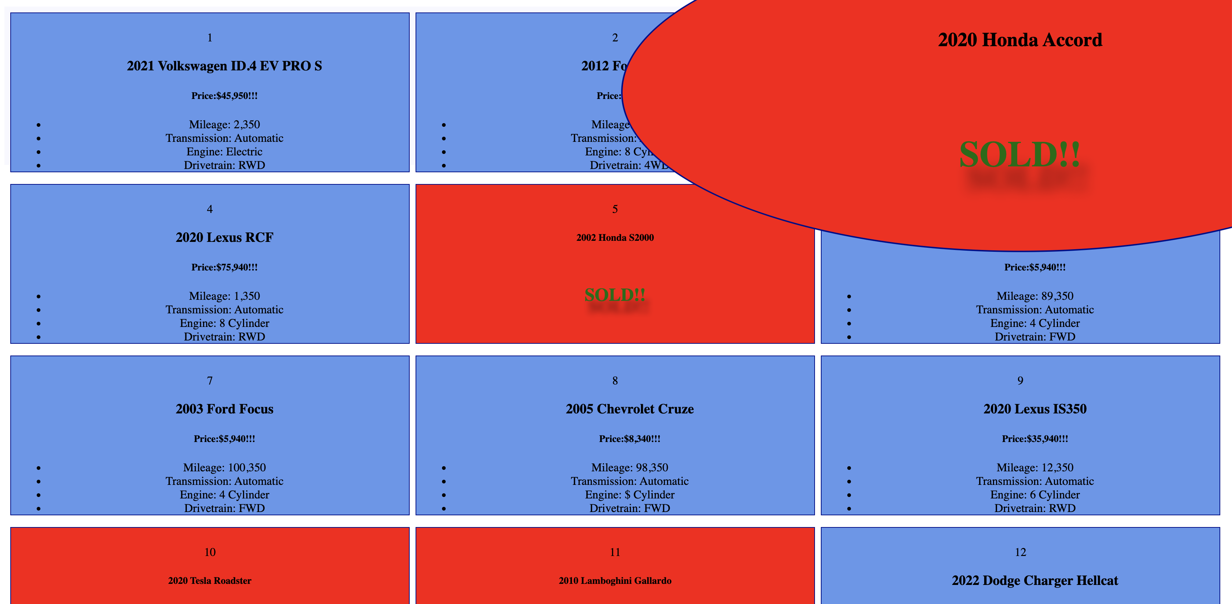

Slide 23
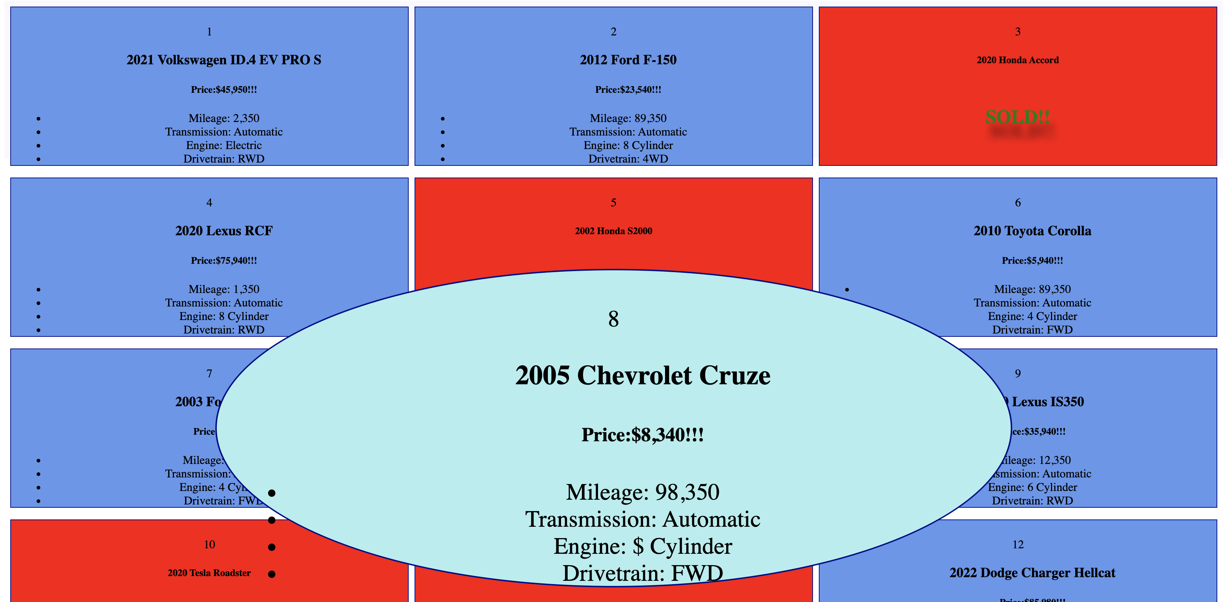

Slide 25
Formatting /
Styling

Slide 26

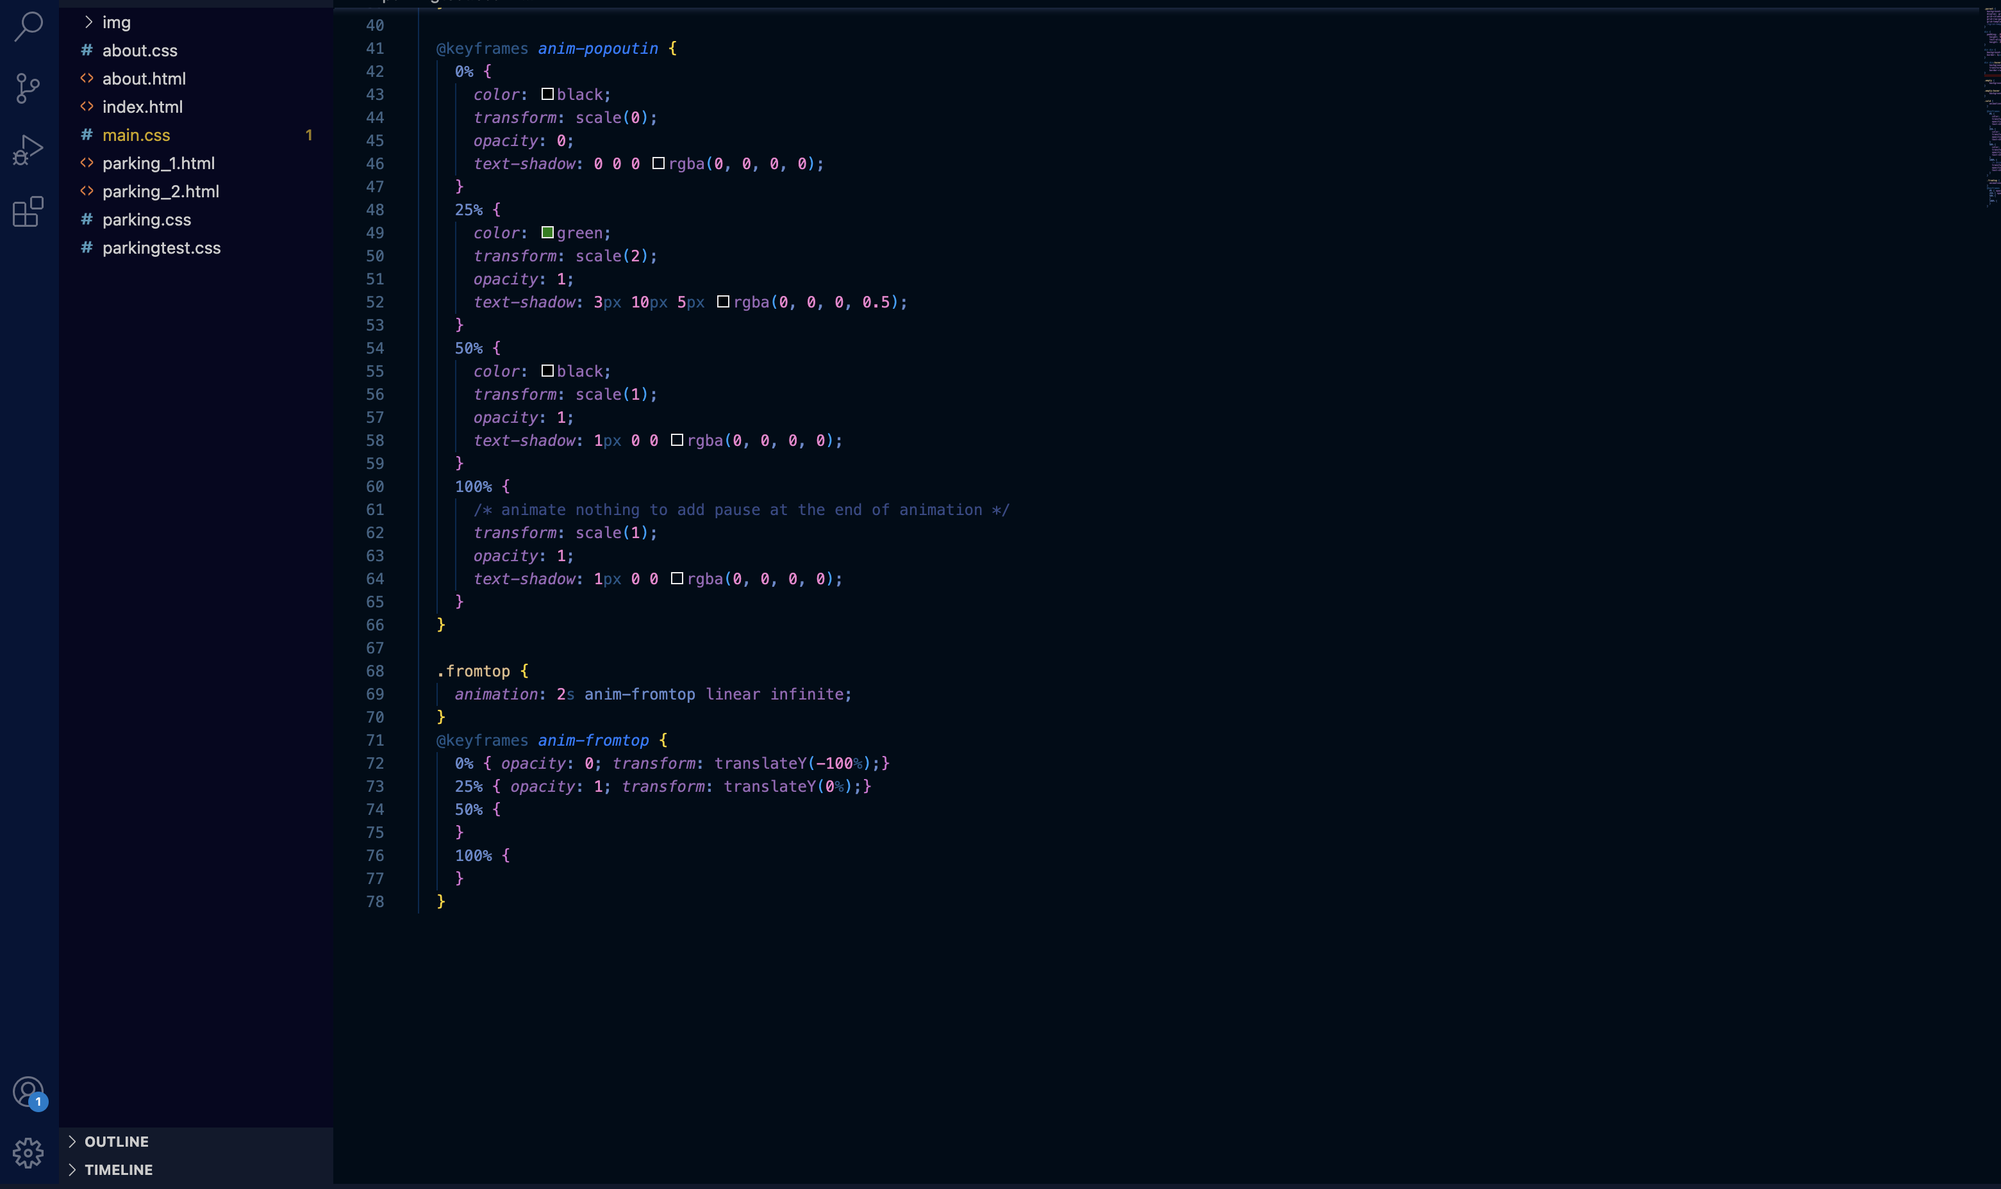

Slide 27
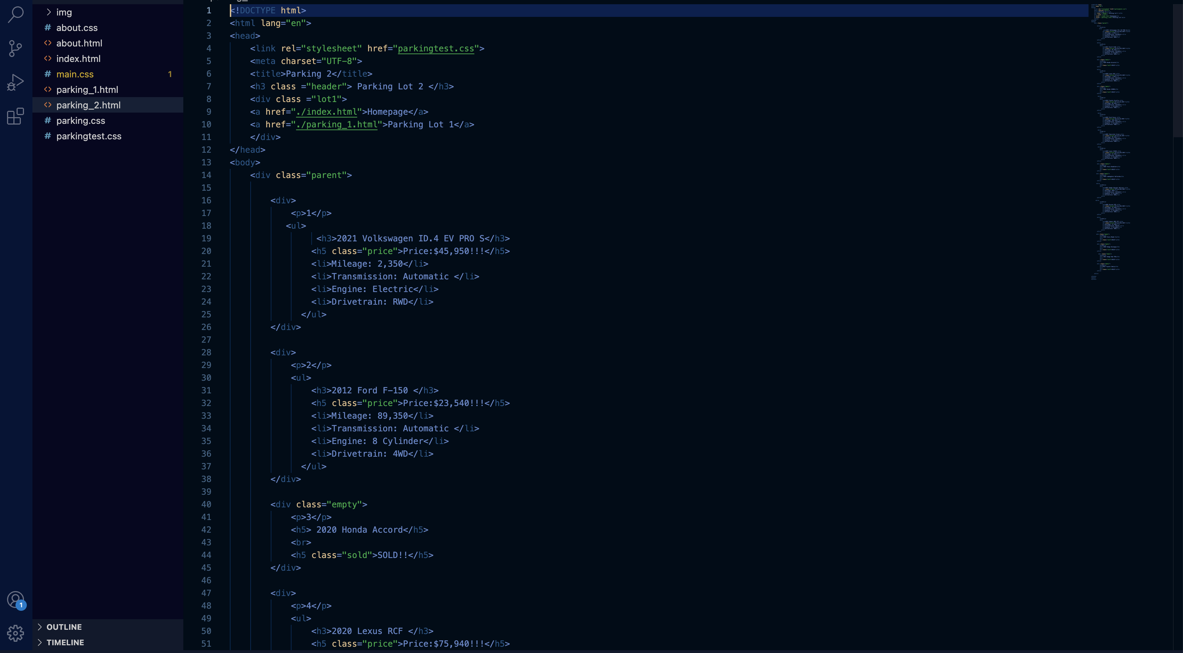


Slide 28
About /
Contact Page

Slide 29
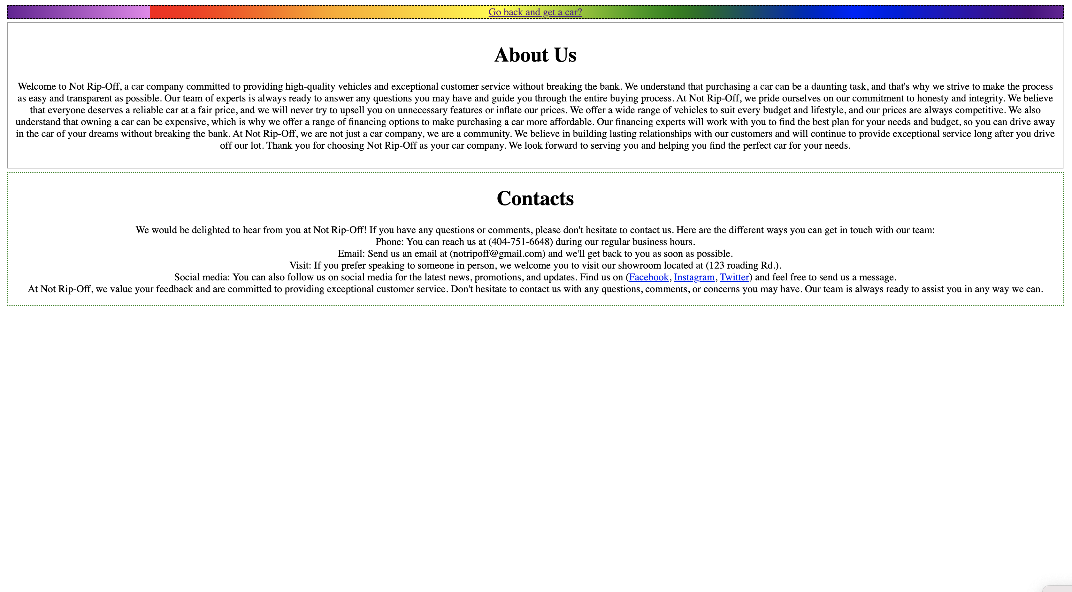

Slide 30
Formatting /
Styling

Slide 31
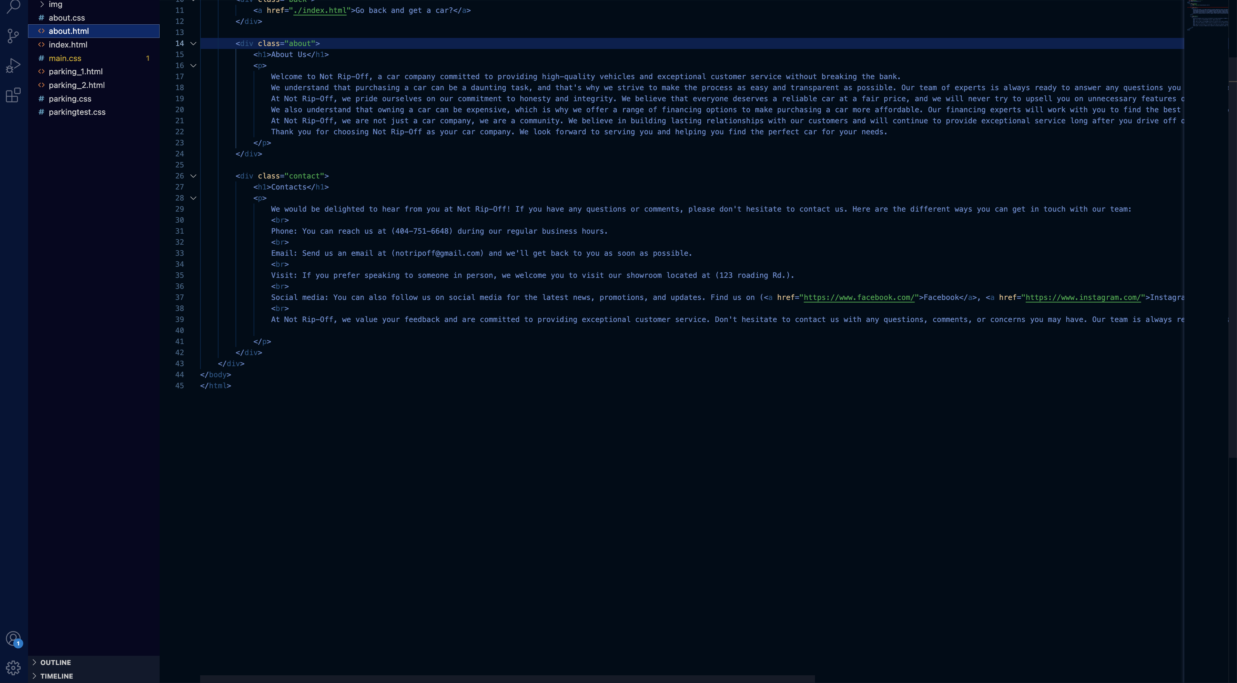

Slide 32
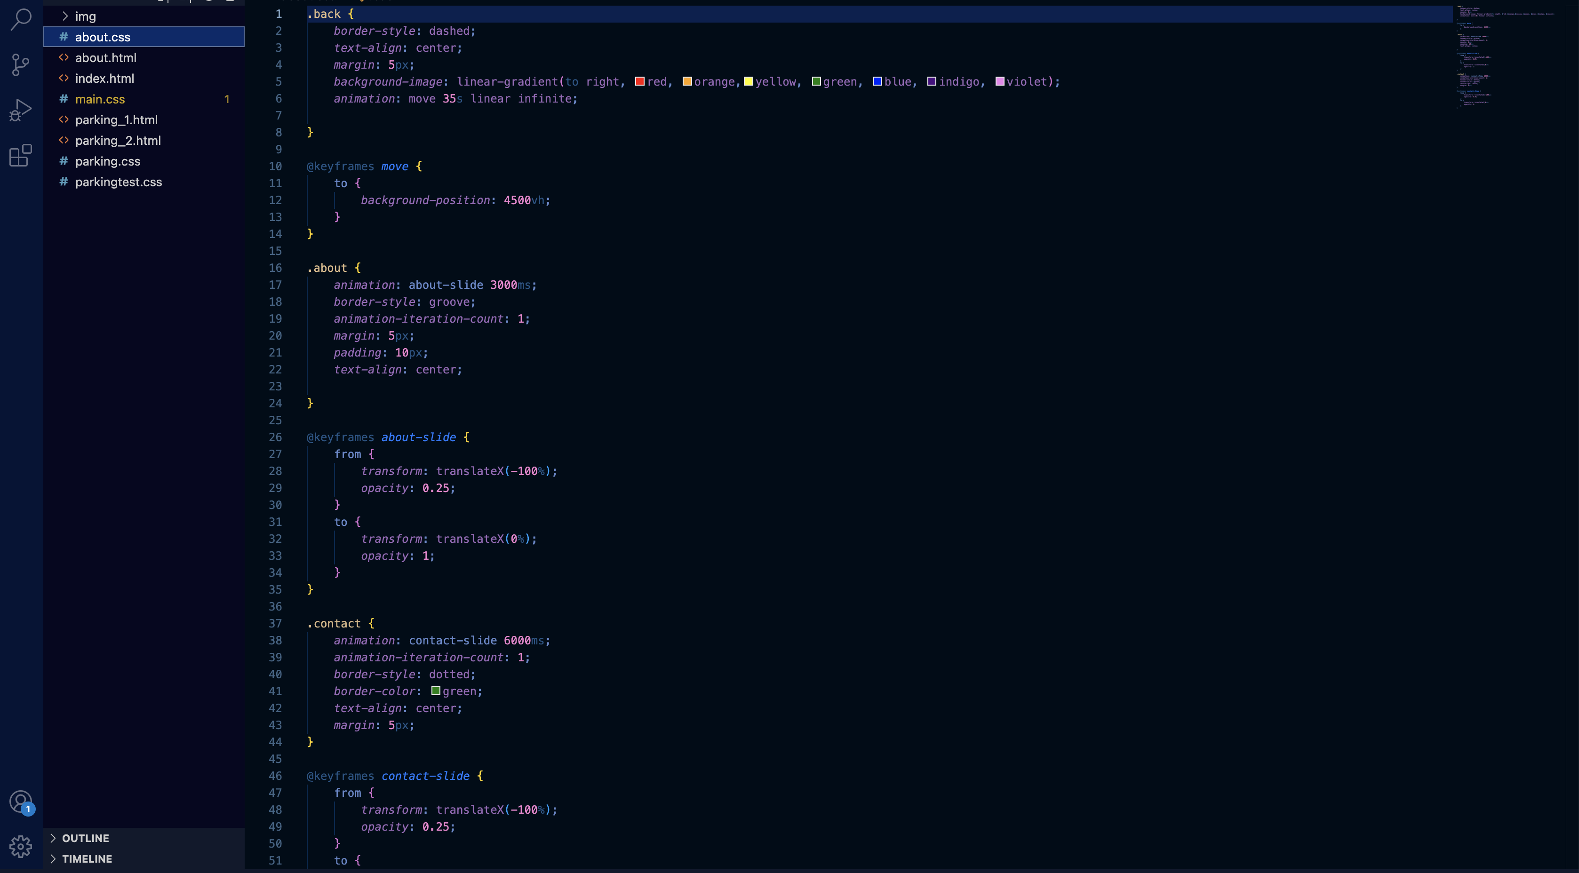
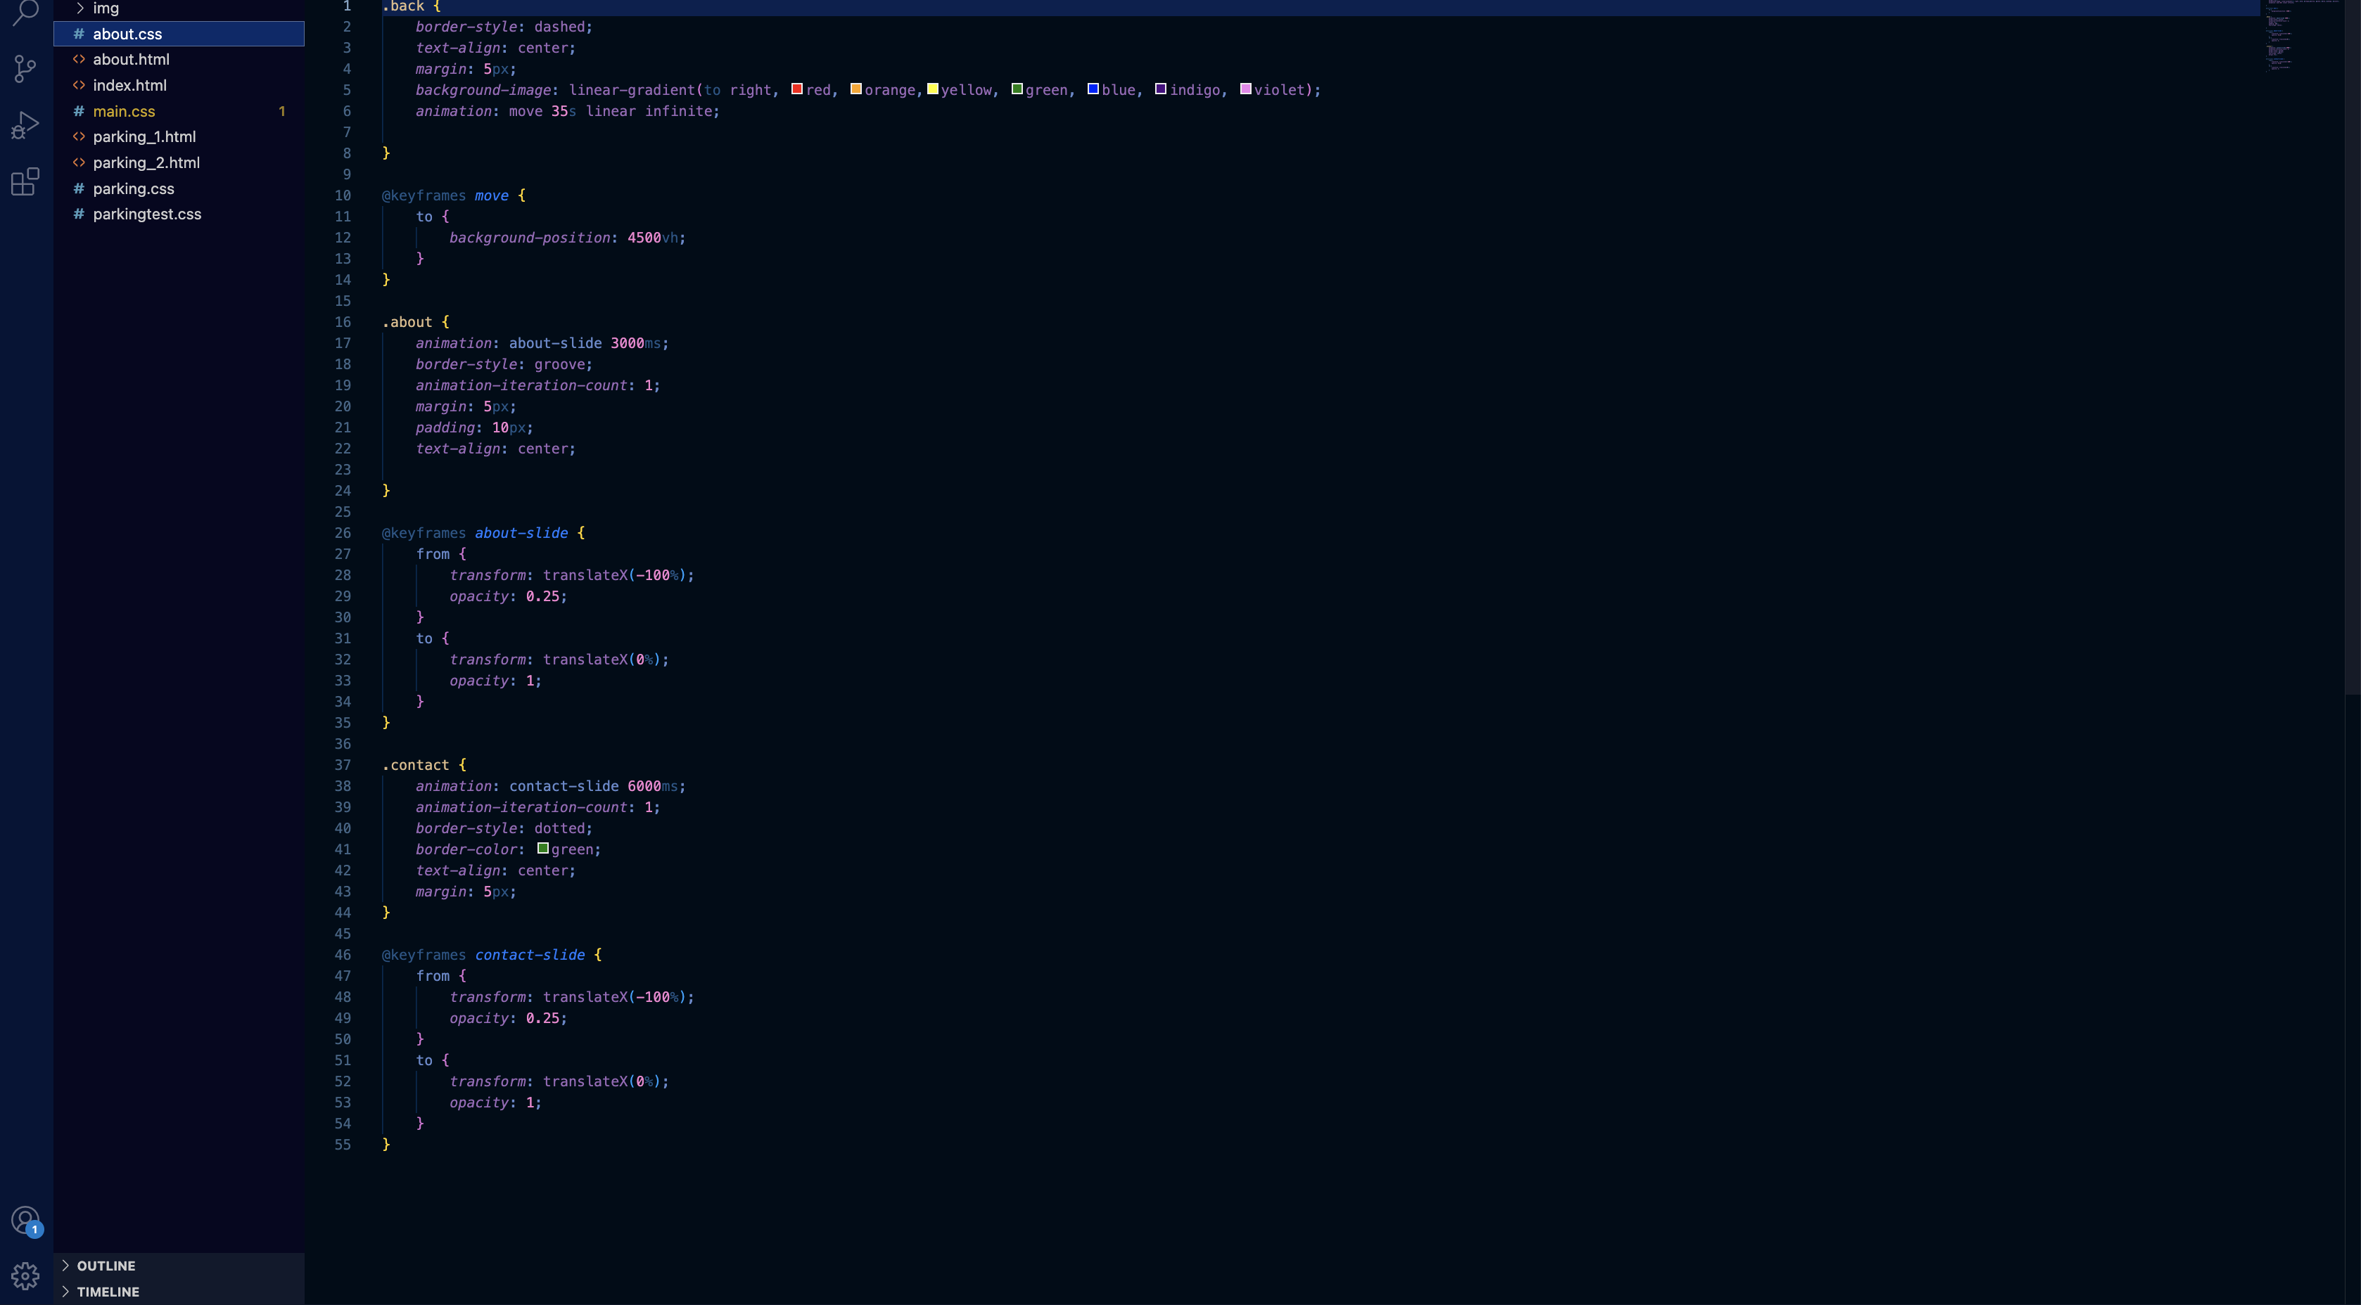

Slide 33


Special Offer

Slide 34
Special Offer

Slide 35

Thank You

Slide 36
Thank You

